Slide 1
BOARD INFINITY
EXCEL CAPSTONE PROJECT
TOPIC – BUILDING DASHBOARD & ANALYSIS ON
SUPERSTORE DATA
SUBMITTED BY – RISHIKESH AMLE

Slide 2
WHAT I HAVE DONE IN MY PROJECT
Analysis on Superstore dataset( Source – Sample-superstore tableau).
Identification of different Problem Statements based on dataset.
Creation of different Charts Depending on Problem Statements using pivot tables & functions.
Building a Dynamic Excel Dashboard ( 1 &2) & explanation of all problem Statements.

Slide 3
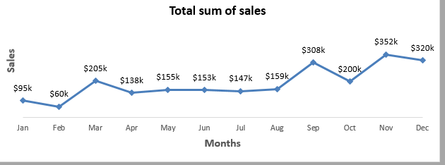
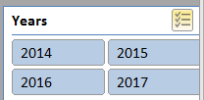
PROBLEM STATEMENTS(DASHBOARD – 1)
What is the sum of sales according to months in all 4 years?
A pivot table is created on sales & order date & based on that A line chart is prepared .Slicers are also inserted So that we can Sum according to years. Following are the Snapshots of charts which will lead to better understanding of our problem.
Fig 1B.Slicer
Fig 1A. Line chart for Total sum of Sales in months

Slide 4
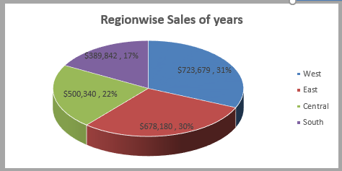
What are the region wise sum of sales ?
A 3- D bar chart is prepared for 4 regions.
Fig 2 – Regionwise sum of sales

Slide 5
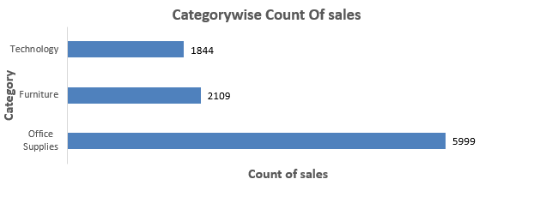
What are the category wise Count of sales?
A bar chart is prepared with the help of pivot tables, which shows count of all 3 categories.
FIG 3 – Categorywise Quantity of sales

Slide 6
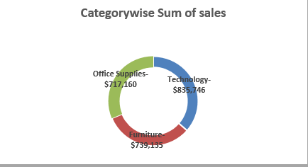
What are the category- wise sum of sales?
A Doughnut chart is prepared to shows Sales of all three categories Furniture,Technology & office Supplies.
FIG 4 – Category- wise sum of sales

Slide 7
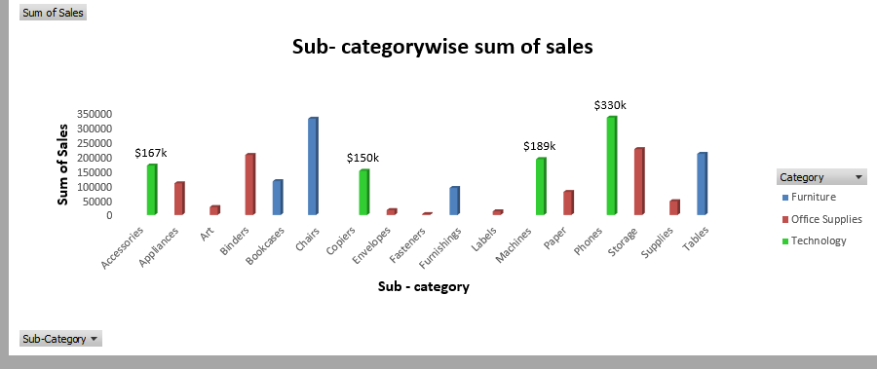
What are the Sub –Category wise Sum of Sales ?
A 3- D Stacked column is Created which shows all Sub categories, Field buttons on chart helps us to choose a particular category to identify sales of subsequent sub-categories .
FIG 5 - Sub –Category wise Sum of Sales

Slide 8
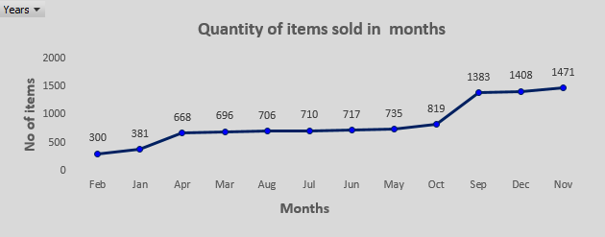
PROBLEM STATEMENTS (DASHBOARD – 2)
What are the Quantities of items sold according to months in all 4 years?
For this a line chart is created which shows no of items on y axis & months in x- axis.Year field button helps us to select different years for analysis.
FIG 6 - Quantities of items sold according to months

Slide 9
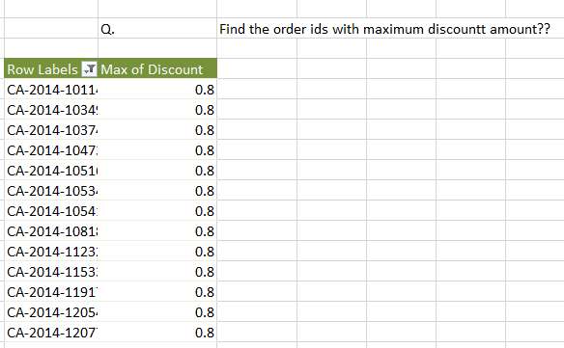
Find the order id’s with maximum discount amount ?
For this Only a pivot table is used to identify order ids with maximum discount amount .No chart is prepared for this problem statement ,pivot table is created in sheet 4.The Pivot table is shown below
FIG 7 - order id’s with maximum discount

Slide 10
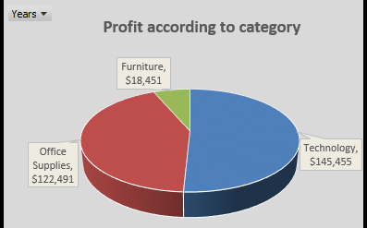
Which Category has the highest Sum Of profit in all 4 years?
For this a 3-d pie chart is prepared which Profit in all 3 categories & according to this technology items shows highest profit.The year field button helps us to identity profit in each year.
FIG 8 - Profit in every category

Slide 11
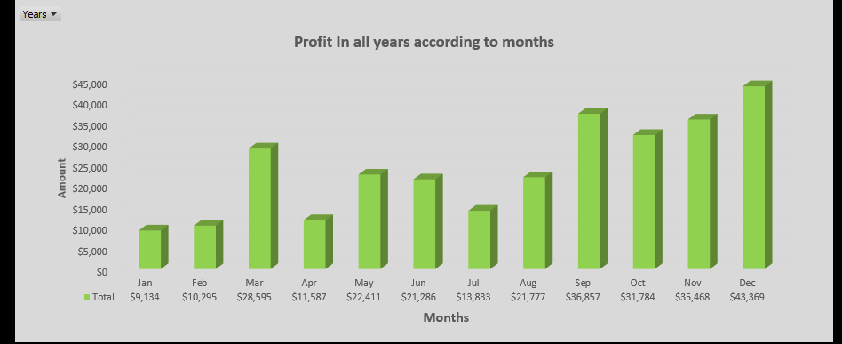
What are the profits according to months in all 4 years ?
For this a 3-D stacked column chart is prepared . The year field button helps us to identity profit in each year for better analysis.
FIG 9 - Profits according to months

Slide 12
RESULT & INSIGHTS FROM SUPERSTORE ANALYSIS
West – region has higher sales compared to other 3 regions.
Quantity of sales is higher for office supplies , but sum of sales is greater for technology items as compared to other categories.
The sales in November & December months is much higher as compared to other months in all years.
The profit is much higher in technology items and less in furniture items.
The profit is much higher in last quarter of every year compared to first 2 quarters .

Slide 13
CONCLUSION
Proper Analysis is done for the Superstore database.
A Dynamic Dashboard is constructed & many insights can be found with the help of that dashboard.
Superstore should focus on east ,north & south region for more sales.
Superstore should also focus on first 2 quarters of the year to increase their profit.
The video link to get better overview of this presentation is
https://drive.google.com/drive/folders/1bKtEiWCSpo-x9C2FOcDIgy_57hgSPchz?usp=sharing

